Slide 1
6G4Z0024 Web Development Lecture 3: Scalable styling and introduction to JavaScript
Ashley Williams
ashley.williams@mmu.ac.uk

Slide 2
Learning Objectives
To understand what we mean by responsive design and how we can make our websites responsive
To understand the basics of JavaScript and where JS is useful

Slide 3
Unit Structure
# | W/C | Lecture | Lab
1 | 24/1/22 | Intro to the Unit; History; How the web works; Intro to HTML | Basic HTML
2 | 31/1/22 | HTML Forms; Intro to CSS | HTML Forms; Basic CSS
3 | 7/2/22 | Layouts with HTML and CSS; Responsiveness; Intro to JS | CSS Layouts; Basic JS
4 | 14/2/22 | JS for performing basic tasks | Working with JS
5 | 21/2/22 | REST APIs; Dynamic pages with JS | Sending/Receiving HTTP requests with JS
6 | 28/2/22 | Assignment; Next Steps | Assignment Support

Slide 4
Last week recap
HTML Forms – getting input from the user (step one towards making websites interactive)
Basic CSS – make things pretty

Slide 5
Assignment
Build a website for your favourite band/musician
Your website needs to adhere to certain requirements
HTML (30%); CSS (25%); Javascript (45%) – You can make a start now!
Fresh in your mind
Will take a lot longer than you think

Slide 6
Assignment – HTML (30%)
You should design your site, making use of the following HTML features:
Multiple pages with a way of navigating between the pages using anchor tags
Pages that are divided into sections using the HTML <div> tag
Use of headers and paragraphs for organising and displaying content about the musician
Use of HTML lists (ordered or unordered)
Use of images throughout the website with an appropriate alternative text attribute
All HTML pages should be well formed and validated through https://validator.w3.org/#validate_by_input

Slide 7
Assignment – CSS (25%)
Standard (20%)
You should style your site by making use of Cascading Style Sheets. Specifically, you will be marked on the following aspects:
Your style rules should be in an external style file (with a .css extension) and linked to from within your HTML files
You must have styled your website in terms of layout/positioning, text and content
You must have demonstrated appropriate use of classes and ID’s to style groups and individual components
Extension exercise (5%) – medium difficulty
Make your website responsive. Your submission should include a text file containing a short paragraph that describes the efforts you have made to make your site responsive.
(This week's content)

Slide 8
Questions?

Slide 9
Websites should be responsive…
What do we mean by responsive?

Slide 10
Responsive Design
A design that works and looks good on all devices, screen sizes, resolutions
The site will auto adjust accordingly to the viewport
The move to mobile-first design
Remember the scalable stick man in Programming 1?
Scalable using percentages over fixed sizing

Slide 11
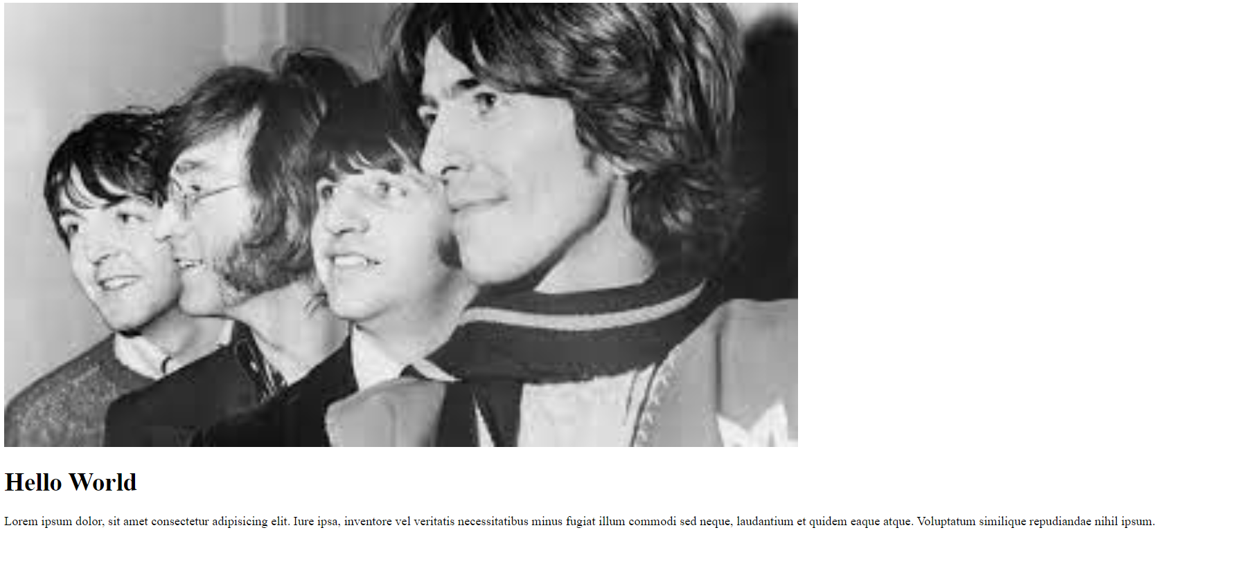
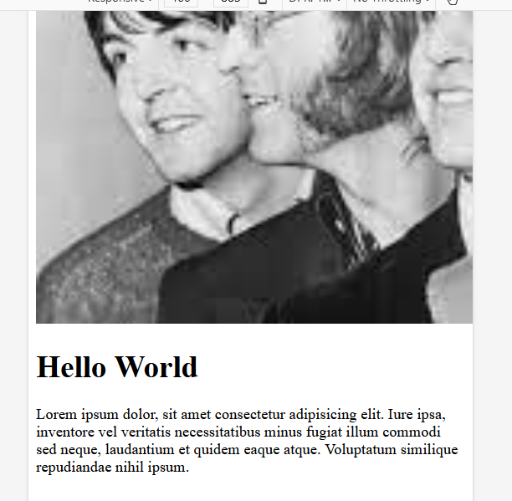
Example
This image has a width of 1000px.
While it looks ok on desktop, it is cropped on smaller screens

Slide 12
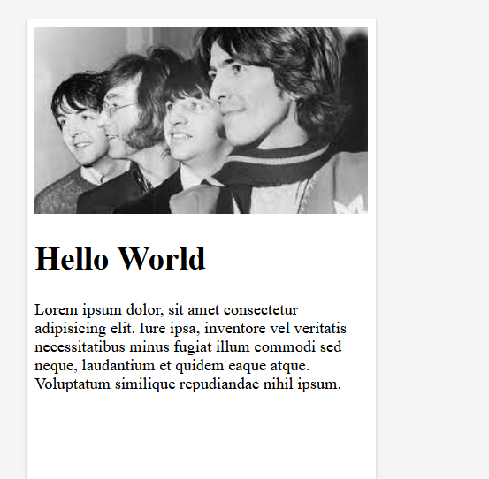

How to we make websites responsive?
Instead, we can set the width to 100%
Now the image scales with the screen size

Slide 13
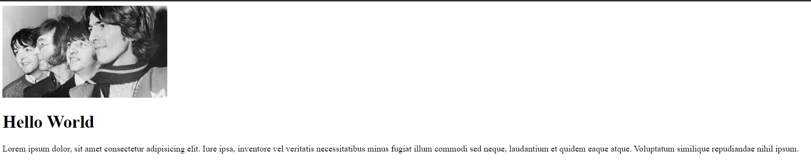

How to we make websites responsive?
However, on wide screens, the image now takes over an pixelates
We can instead use the max-width property
The image will scale down, but never scale up larger than its original size

Slide 14
How to we make websites responsive?
Viewport: the area of the window in which web content can be seen (often not the same size as the rendered page, so the browser applies scroll bars)
We can set the viewport to always be the same as the width of the current device

Slide 15
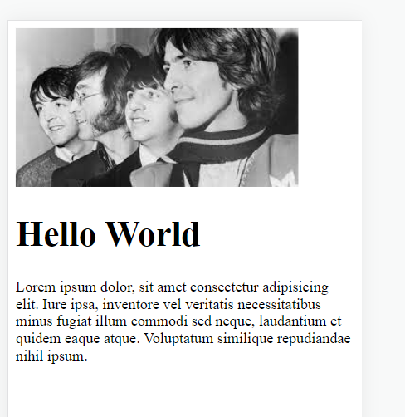
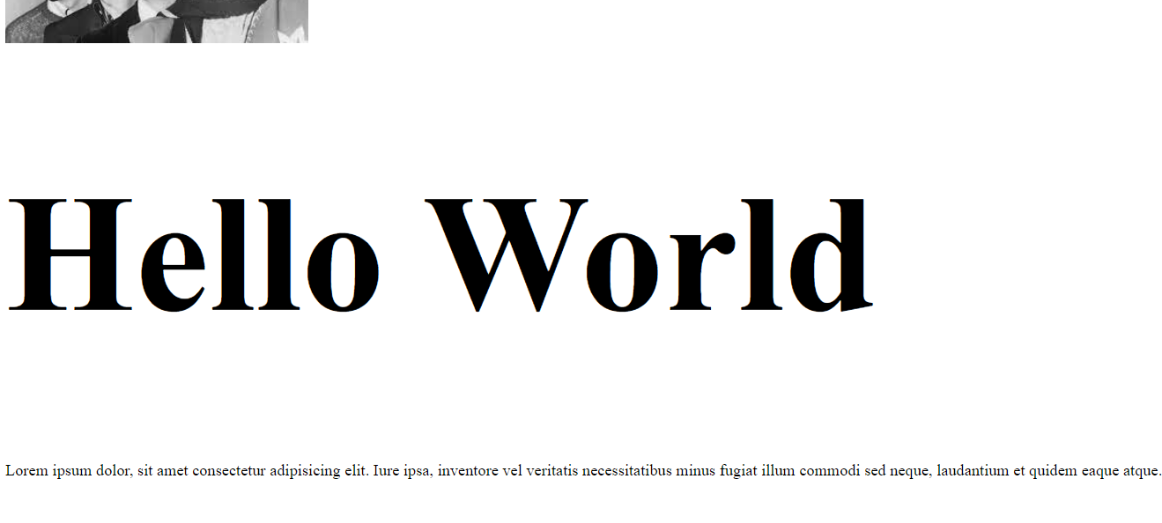
How to we make websites responsive?
For scalable elements and text, instead of using pixels and %, we can use viewport width and viewport height (vw and vh) to scale with the viewport

Slide 16
Layout frameworks: Flexbox
Rather than code everything from scratch, CSS includes some handy frameworks for building UI’s
Flexbox is one such framework
Flexbox allows you to dynamically allocate space in the viewport
You give each of your elements a flex number, the numbers are summed and the screen is divided by the total number, allocating the given proportions for each component

Slide 17
Layout frameworks: Flexbox
Demo: flexbox_1.html
What if we remove stop displaying as flex by removing the container style?
Flex direction – the boxes appear in a row, we can change this by setting the flex-direction of the container (column, row, row-reverse, column-reverse)

Slide 18

Layout frameworks: Flexbox
Notes:
https://www.youtube.com/watch?v=K74l26pE4YA&ab_channel=Fireship

Slide 19
Layout frameworks: Flexbox
Flexbox is a lot to remember and to get your head around. Especially if you are new to it. However, there is a game to help you learn quickly and understand the concepts:
https://flexboxfroggy.com
You will be playing flexboxfroggy in the labs this week

Slide 20
How can we test our designs?
Demo: flexbox_1.html
Most browsers allow you to test designs on multiple screen sizes
Open your website and in the settings, open the developer tools
You can change your device/screen size at the top of the page.

Slide 21
Questions?

Slide 22
Where are we up to?
HTML – defines the structure of the content
CSS – allows us to make things pretty
Neither are “programming languages”
We need something that can handle all of the interactivity
Handle the form data
Turn our websites into web applications
Website: a group of globally accessible, interlinked pages (static)
Web App: software which is accessible using a web browser

Slide 23
JavaScript – the programming language of the web!
Welcome to JavaScript
Easy to learn
The world's most popular programming language
The language of the web
Program the behaviour of web pages
But, it can be a bit weird at times…

Slide 24
Linking JavaScript to your website
We store our JavaScript scripts in their own files (.js extension)
Like with CSS, we then import the script into our web pages
This can be done anywhere, but for this Unit, you can add it inside the <head> element
<script src="myScript.js"></script>

Slide 25
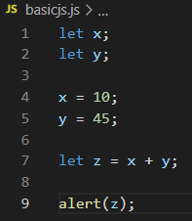
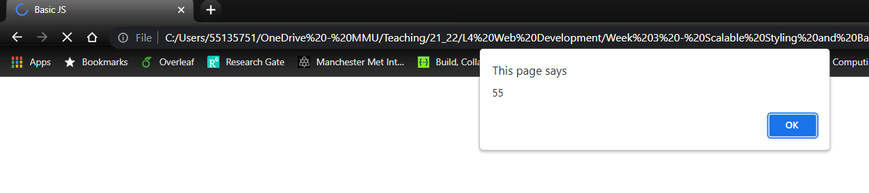
JavaScript Basics: variables
Variables declarations: use let and const
Variables aren’t typeset (like in Java), you can switch variables between different datatypes
Note, the page hasn’t loaded in the browser yet because the script runs in the <head>

Slide 26
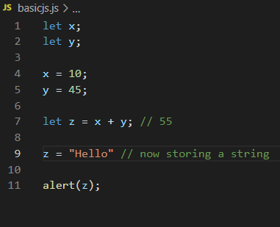
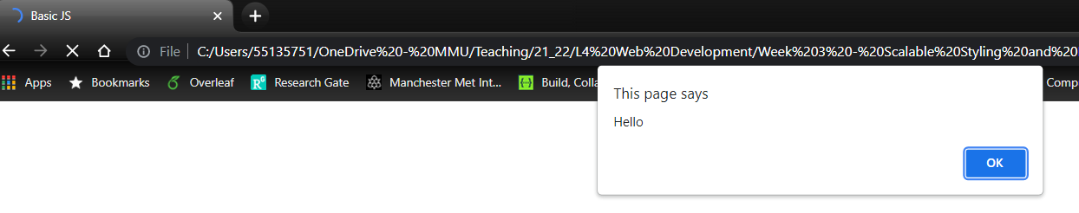
JavaScript Basics: variables

Slide 27
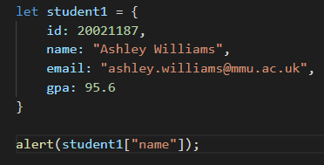
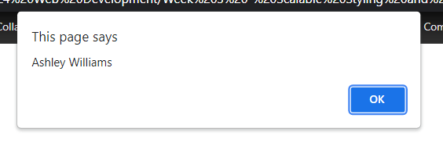
JavaScript Basics: Objects
JS objects are used a lot in application development
E.g. displaying large amounts of data, sending data to servers for processing
key/value pairs; comma separated

Slide 28

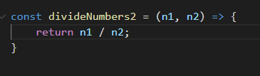
JavaScript Basics: Functions
There are two ways of writing functions
Arrow functions (on the right) are preferred, but both work
Why?
They are a little more flexible as we will see in later weeks.
For now, it would just be best you get used to them

Slide 29
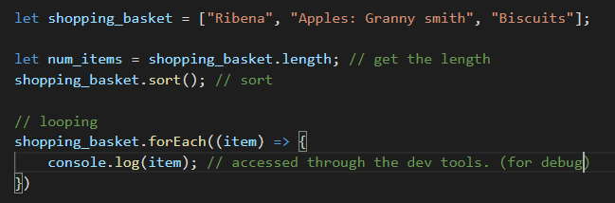
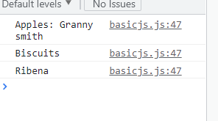
JavaScript Basics: Arrays
Note the arrow function here – this is an anonymous function (cleaner and quicker)

Slide 30
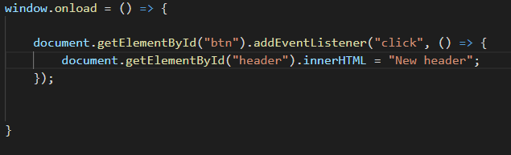
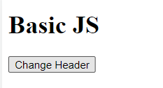
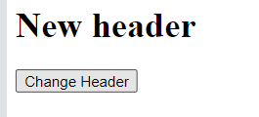
JavaScript Basics: Interaction
All very good, but how is it relevant to web site development?
Well, we can make our JS interact with our site, make changes to our site, and handle events (e.g. button clicks, page loads)
This means that we can essentially do anything with JS
Looks scarier than it is…

Slide 31
This week's lab
Learn to create responsive websites using flex
Start to play around with the basics of JavaScript

Slide 32
Questions?

Slide 33
Sources
https://www.guru99.com/difference-web-application-website.html
https://www.w3schools.com/html/html_responsive.asp
https://www.w3schools.com/js

